Slide 1
Diversity, Segregation and Disparity
Key concepts in reporting on race
IRE New York Watch Dog Workshop, January 27, 2017

Slide 2
Diversity, Segregation and Disparity
DIVERSITY: WHAT IS IT AND HOW DO YOU MEASURE IT?
IRE New York Watch Dog Workshop, January 27, 2017

Slide 3
Diversity, Segregation and Disparity
DIVERSITY: WHAT IS IT AND HOW DO YOU MEASURE IT?
Diversity is sometimes confused with “minority/non-minority” – it is not the same thing. Diversity is all about the mixture of people, and when measuring diversity, what we’re after is literally the chance that two people chosen at random from the population will be different.
IRE New York Watch Dog Workshop, January 27, 2017

Slide 4
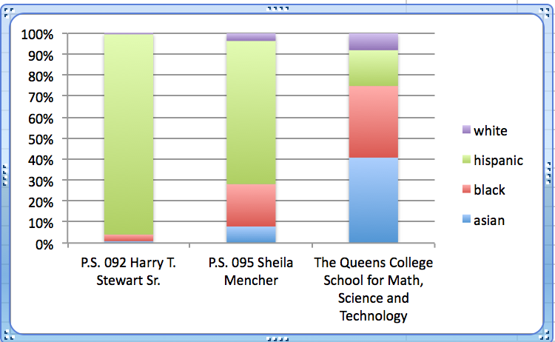
Diversity, Segregation and Disparity
IRE New York Watch Dog Workshop, January 27, 2017

Slide 5
Diversity, Segregation and Disparity
9
49
68
IRE New York Watch Dog Workshop, January 27, 2017

Slide 6
Diversity, Segregation and Disparity
DIVERSITY: WHAT IS IT AND HOW DO YOU MEASURE IT?
The use of diversity measures in journalism was pioneered in the early 90s by Phil Meyer of the University of North Carolina and Shawn McIntosh of USA Today. For the formula, you calculate the percentage of the total for each group, sum the squares, and subtract it from one. See: http://www.usatoday.com/story/news/nation/2014/10/21/diversity-index-data-how-we-did-report/17432103/
IRE New York Watch Dog Workshop, January 27, 2017

Slide 7
Diversity, Segregation and Disparity
DIVERSITY: WHAT IS IT AND HOW DO YOU MEASURE IT?
In MySQL, for example, the formula looks like this, where w= White, b=Black, h=Hispanic, a=Asian, na=Native American,o=Other, ttot=Total
diversity=(1-(POW(wtot/ttot,2)+POW(btot/ttot,2)+POW(htot/ttot,2)+POW(atot/ttot,2)+POW(natot/ttot,2)+POW(otot/ttot,2)))*100
WHERE ttot>0
IRE New York Watch Dog Workshop, January 27, 2017

Slide 8
Diversity, Segregation and Disparity
SEGREGATION: WHAT IS IT AND HOW DO YOU MEASURE IT?
Segregation measures look at two groups and determine the extent to which they are apart. This is done by taking the overall population of the two groups in a given place (such as a metropolitan area) and then assessing how individual neighborhoods (such as Census Tracts) compare to the total.
IRE New York Watch Dog Workshop, January 27, 2017

Slide 9
Diversity, Segregation and Disparity
SEGREGATION: WHAT IS IT AND HOW DO YOU MEASURE IT?
In other words, if the mix of Whites and Blacks in a metropolitan area is 75-25, the formula assesses how close individual neighborhoods in the metro match the overall mix. Professor Michael Rosenfeld of Stanford posted some examples (https://web.stanford.edu/~mrosenfe/)
IRE New York Watch Dog Workshop, January 27, 2017

Slide 10
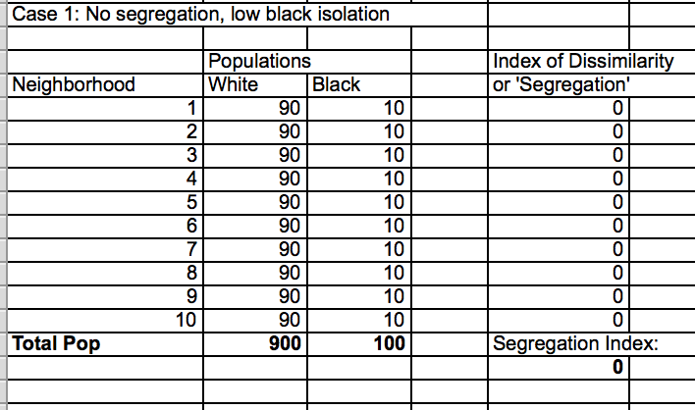
Diversity, Segregation and Disparity
IRE New York Watch Dog Workshop, January 27, 2017

Slide 11
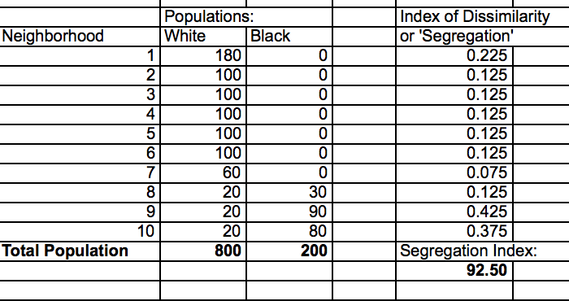
Diversity, Segregation and Disparity
IRE New York Watch Dog Workshop, January 27, 2017

Slide 12
Diversity, Segregation and Disparity
SEGREGATION: WHAT IS IT AND HOW DO YOU MEASURE IT?
Download Professor Rosenfeld’s spreadsheet to learn more about the formula, but the quick explanation:
Each row generates a coefficient:
=ABS((B113/B$101)-(C113/C$101))
Translated: For each neighborhood, we’re calculating the percentage of all whites that live there and subtracting the percentage of all blacks that live there.
IRE New York Watch Dog Workshop, January 27, 2017

Slide 13
Diversity, Segregation and Disparity
SEGREGATION: WHAT IS IT AND HOW DO YOU MEASURE IT?
Then to calculate the index score itself:
=SUM(E91:E100)*0.5*100
Translated: This is the sum of each neighborhood’s coefficient, divided by two because there is two groups, and multiplied by 100 to convert into a whole number. If the result is, say 75, it means that 75 percent of group members would have to move to a different neighborhood to achieve perfect integration.
IRE New York Watch Dog Workshop, January 27, 2017

Slide 14
Diversity, Segregation and Disparity
DISPARITY: WHAT IS IT AND HOW DO YOU MEASURE IT?
On the face of it, measuring disparity is as simple as quantifying the difference between groups in whatever category you’re reporting on. But there are still factors to keep in mind, both statistical and journalistic.
IRE New York Watch Dog Workshop, January 27, 2017

Slide 15
Diversity, Segregation and Disparity
DISPARITY: WHAT IS IT AND HOW DO YOU MEASURE IT?
First and foremost, you need to consider whether the differences you’ve measured are significant. There is statistical significance, which you can calculate with a formula, but also common sense – if test scores in your city are two percentage points higher for one group compared to another, the difference might be statistically significant, but is it meaningful? What about a difference of five points?
IRE New York Watch Dog Workshop, January 27, 2017

Slide 16
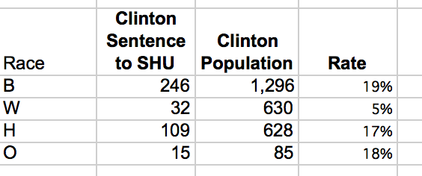
Diversity, Segregation and Disparity
This table shows the racial distribution of inmates sentenced to solitary confinement at the Clinton Correctional Facility in 2015, compared to the overall inmate population. As you can see, white inmates got sent to solitary at much lower rate:
IRE New York Watch Dog Workshop, January 27, 2017

Slide 17
Diversity, Segregation and Disparity
DISPARITY: WHAT IS IT AND HOW DO YOU MEASURE IT?
The difference seems large and obvious. But what if somebody wanted to argue there were only a 402 SHU sentences, the disparity could have happened by chance. For a better explanation of the math, see http://www.biostathandbook.com/chigof.html. Using the “goodness of fit” spreadsheet on this page, let’s look at a data example how to assess this:
IRE New York Watch Dog Workshop, January 27, 2017

Slide 18
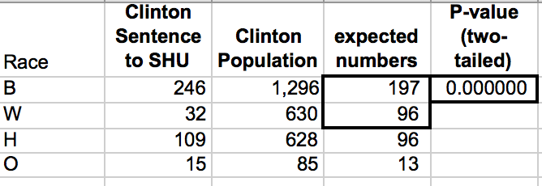
Diversity, Segregation and Disparity
DISPARITY: WHAT IS IT AND HOW DO YOU MEASURE IT?
Chi-square analysis tells you likelihood the difference is by chance…
IRE New York Watch Dog Workshop, January 27, 2017

Slide 19
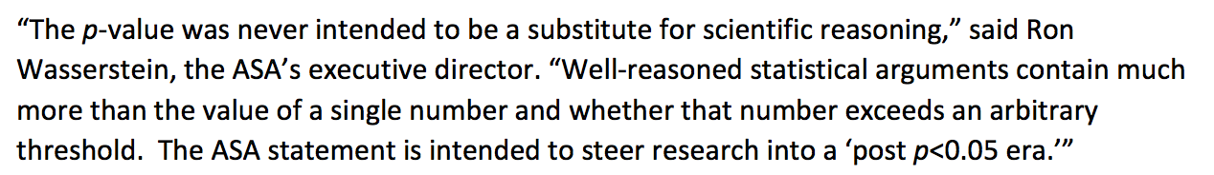
Diversity, Segregation and Disparity
DISPARITY: WHAT IS IT AND HOW DO YOU MEASURE IT?
http://www.amstat.org/asa/files/pdfs/P-ValueStatement.pdf
IRE New York Watch Dog Workshop, January 27, 2017

Slide 20
Diversity, Segregation and Disparity
DISPARITY: WHAT IS IT AND HOW DO YOU MEASURE IT?
An important technique for any data analysis is to “account for” other variables. Example: Does the racial disparity you find hold up for all age groups or is it concentrated among young people?
IRE New York Watch Dog Workshop, January 27, 2017

Slide 21
Diversity, Segregation and Disparity
DISPARITY: WHAT IS IT AND HOW DO YOU MEASURE IT?
Start with your total population, then look at the components. Social scientists – and journalists – often conduct regression analysis to account for multiple factors at once.
See https://www.youtube.com/playlist?list=PL8jfD0J4Etj3Doaj7IirVZW9wJ42DiyJt
IRE New York Watch Dog Workshop, January 27, 2017

Slide 22
Diversity, Segregation and Disparity
DISPARITY: WHAT IS IT AND HOW DO YOU MEASURE IT?
Another thing to consider is scale. All 5-point differences are not alike. It’s important to consider the natural scale of what you’re looking at. What are the lowest values? What are the highest?
IRE New York Watch Dog Workshop, January 27, 2017

Slide 23
Diversity, Segregation and Disparity
DISPARITY: WHAT IS IT AND HOW DO YOU MEASURE IT?
Using school data as an example, if you look at, say, school-level test passing rates, you’ll probably see a range of something like 30 to 90 – a very normal distribution. But if you look at school attendance rates, the range might be from 85 to 99 – much more compressed, and therefore, a five point difference could be much more significant.
IRE New York Watch Dog Workshop, January 27, 2017

Slide 24
Diversity, Segregation and Disparity
DISPARITY: WHAT IS IT AND HOW DO YOU MEASURE IT?
Therefore, a lot of social scientists prefer to “standardize” data into a common scale. One of the most common techniques is to use “z-scores”. Z-scores measure the distance a number is from the average value in standard deviations. See https://github.com/gebelo/gijc/blob/master/Z-Scores.ppt for more information.
IRE New York Watch Dog Workshop, January 27, 2017

Slide 25
Diversity, Segregation and Disparity
Some datasets often used in reporting on disparity:
CURRENT POPULATION SURVEY -- http://www.census.gov/data/tables/time-series/demo/income-poverty/historical-income-households.html
-- Base household income by race --
IRE New York Watch Dog Workshop, January 27, 2017

Slide 26
Diversity, Segregation and Disparity
Some datasets often used in reporting on disparity:
SURVEY OF CONSUMER FINANCE
https://www.federalreserve.gov/econresdata/scf/scfindex.htm -- summary data
http://sda.berkeley.edu/cgi-bin36/hsda?harcscfcomb+scfcomb -- excellent query interface, all years
IRE New York Watch Dog Workshop, January 27, 2017

Slide 27
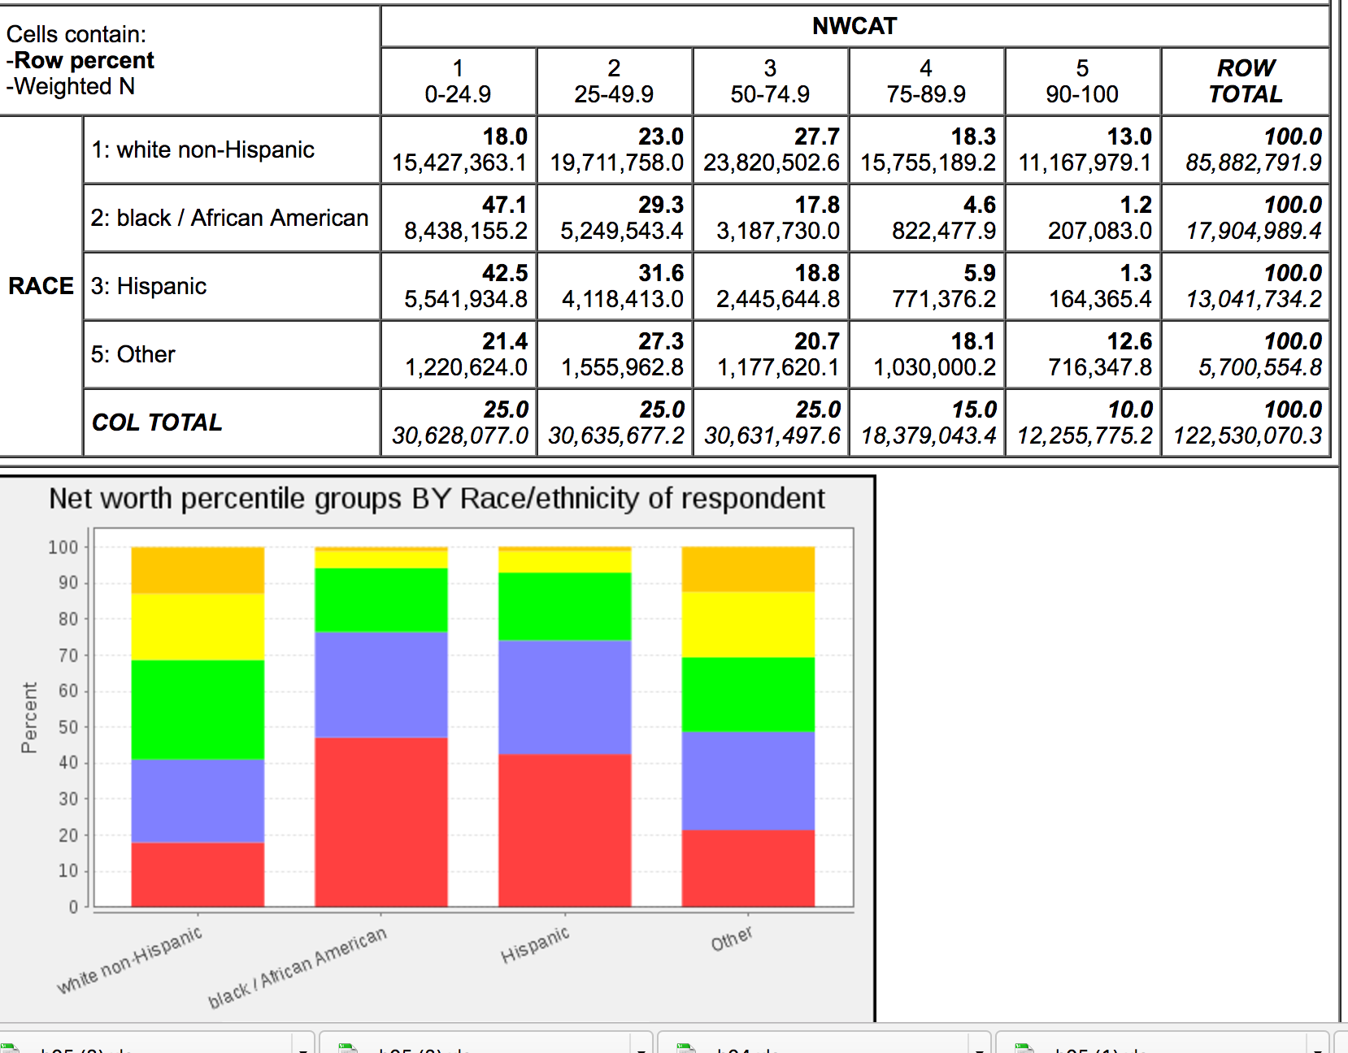
Diversity, Segregation and Disparity
IRE New York Watch Dog Workshop, January 27, 2017

Slide 28
Diversity, Segregation and Disparity
Some datasets often used in reporting on disparity:
HOME MORTGAGE DISCLOSURE ACT DATA (HMDA)
https://ire.org/nicar/database-library/databases/hmda/
IRE New York Watch Dog Workshop, January 27, 2017

Slide 29
Diversity, Segregation and Disparity
Those are just some examples – the best data is often data you collect yourself, either through FOIA or by creating a database from paper records…
IRE New York Watch Dog Workshop, January 27, 2017

Slide 30
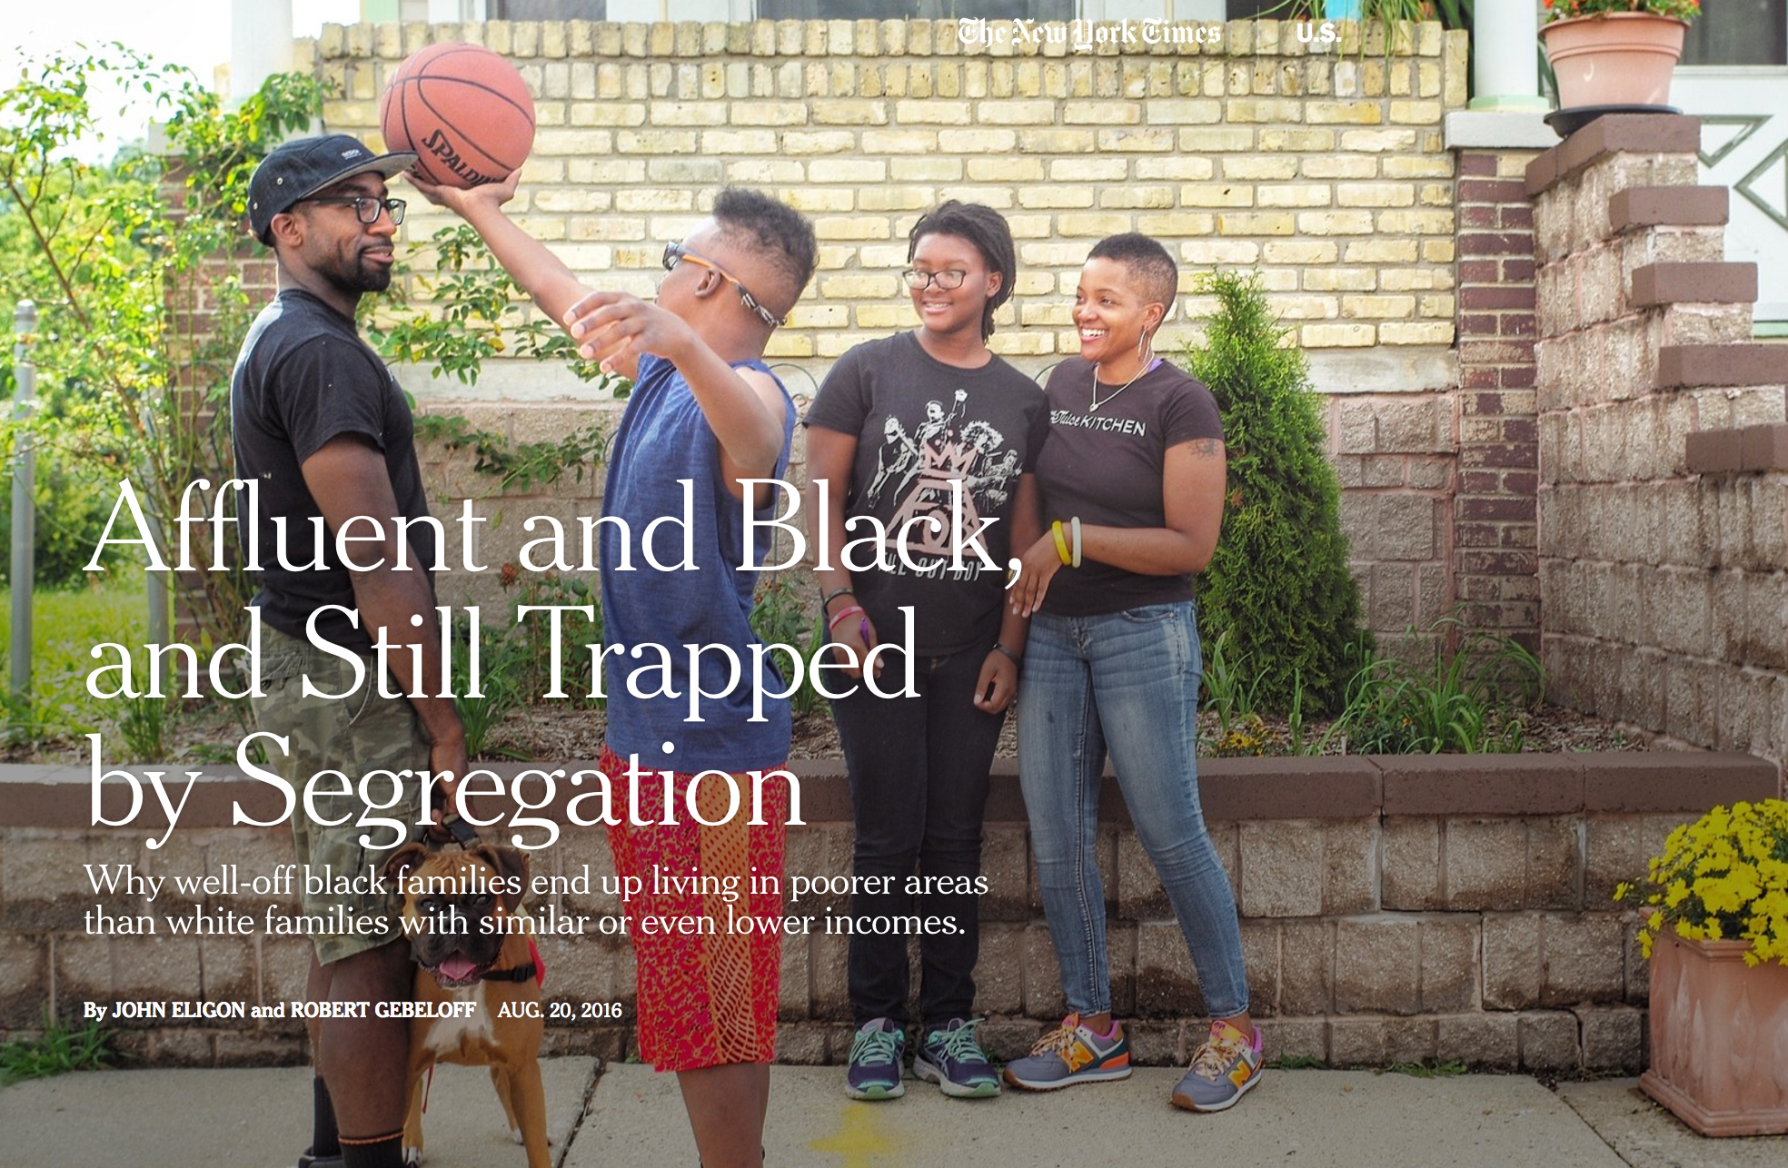
Diversity, Segregation and Disparity
https://www.nytimes.com/2016/08/21/us/milwaukee-segregation-wealthy-black-families.html?_r=0
IRE New York Watch Dog Workshop, January 27, 2017

Slide 31
Diversity, Segregation and Disparity
Many people assume residential segregation is closely related to income disparity – that blacks and whites in particular live apart mostly because of income differences.
To test this, we calculated segregation indexes for all U.S. metros but for all income levels
IRE New York Watch Dog Workshop, January 27, 2017

Slide 32
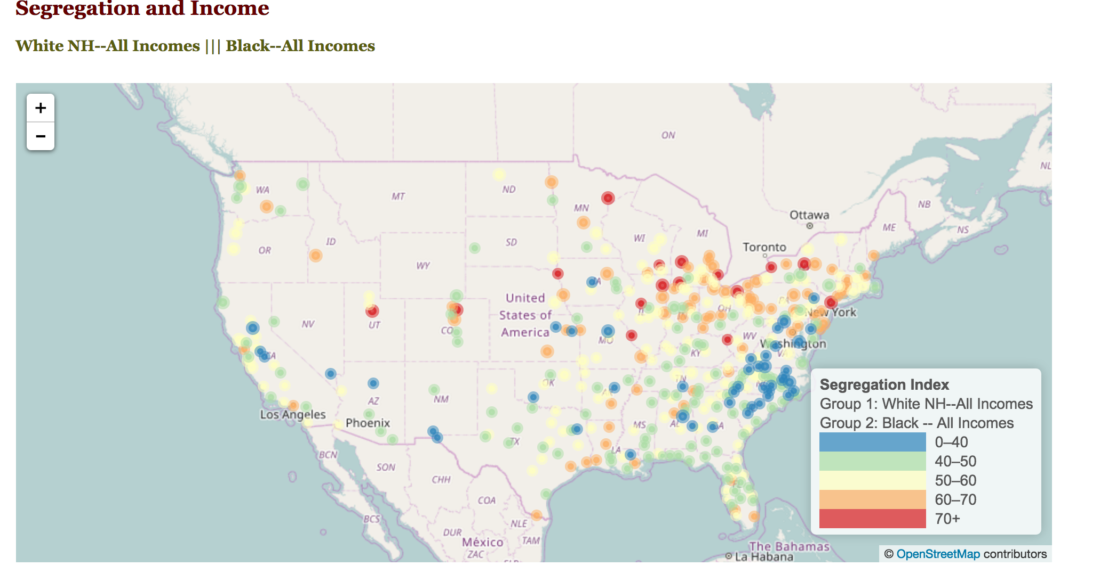
Diversity, Segregation and Disparity
IRE New York Watch Dog Workshop, January 27, 2017

Slide 33
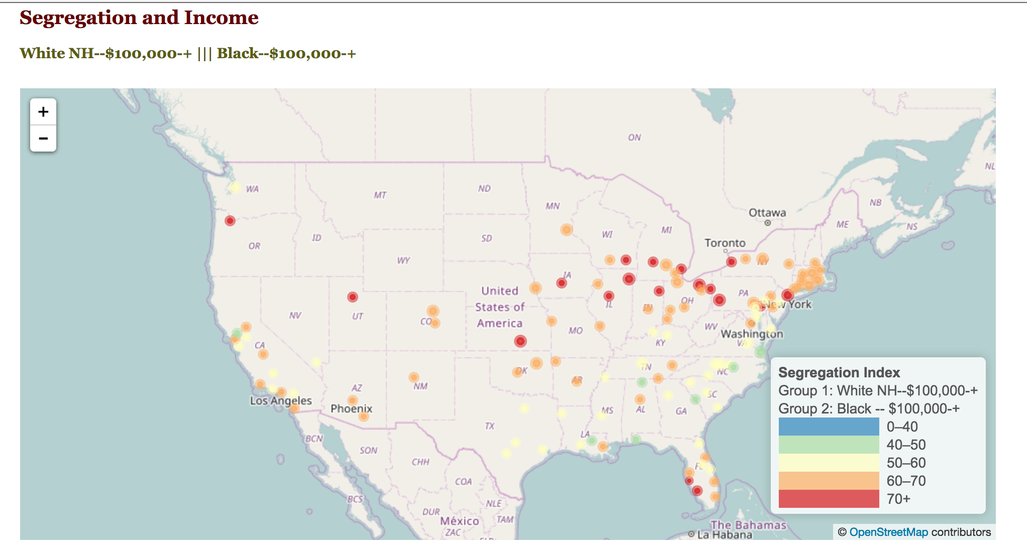
Diversity, Segregation and Disparity
IRE New York Watch Dog Workshop, January 27, 2017

Slide 34
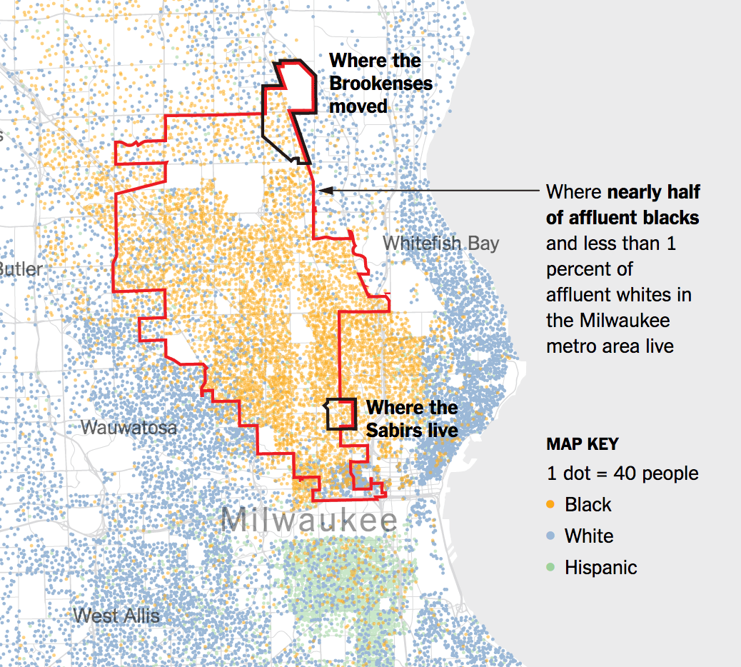
Diversity, Segregation and Disparity
IRE New York Watch Dog Workshop, January 27, 2017

Slide 35
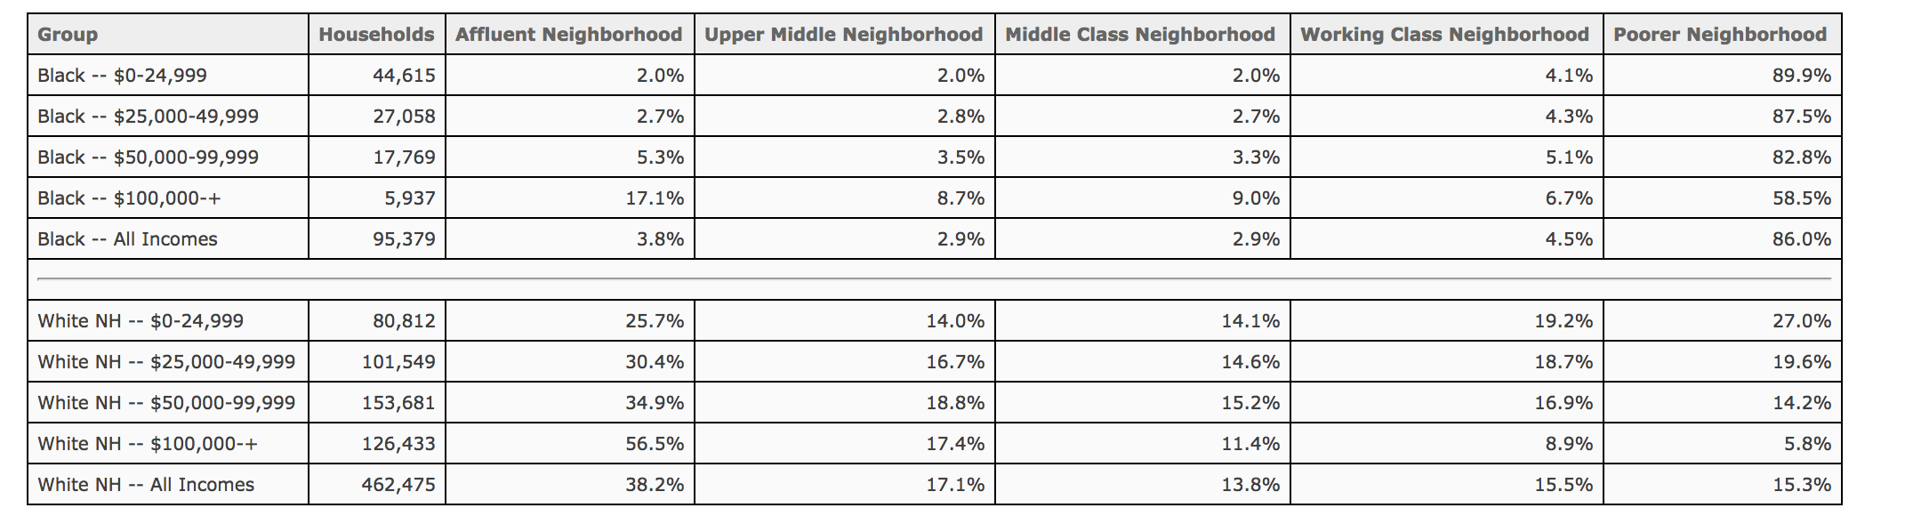
Diversity, Segregation and Disparity
IRE New York Watch Dog Workshop, January 27, 2017

Slide 36
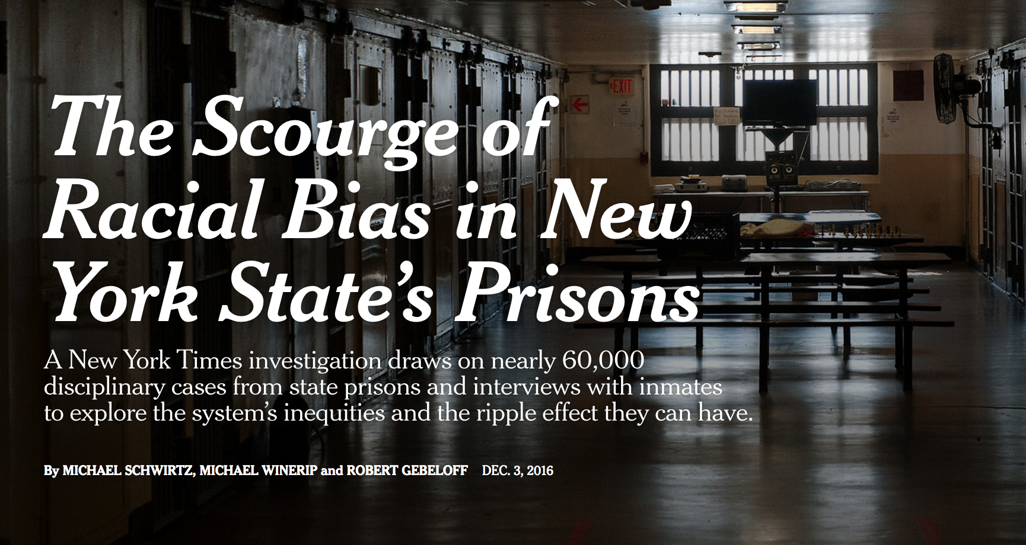
Diversity, Segregation and Disparity
IRE New York Watch Dog Workshop, January 27, 2017

Slide 37
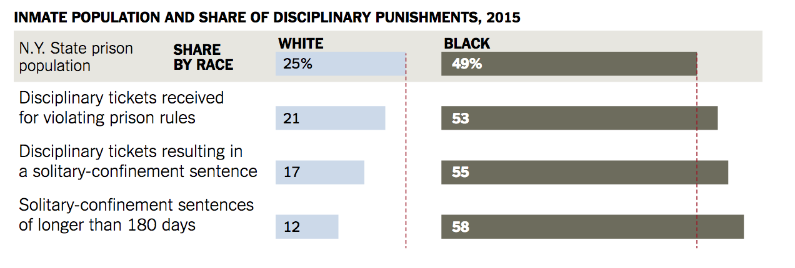
Diversity, Segregation and Disparity
IRE New York Watch Dog Workshop, January 27, 2017

Slide 38
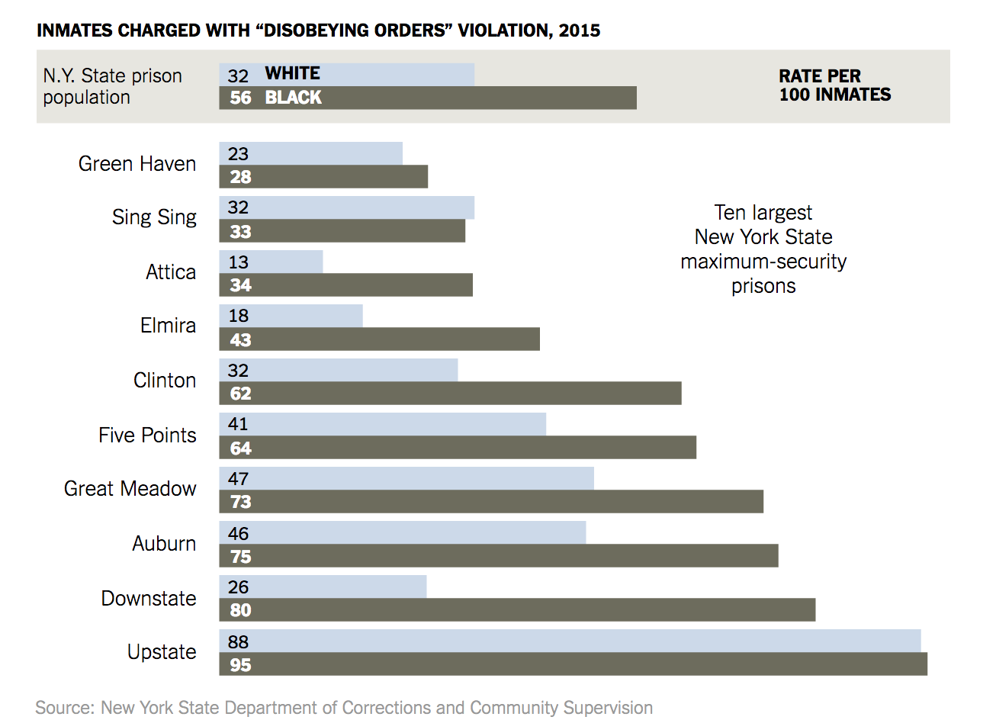
Diversity, Segregation and Disparity
IRE New York Watch Dog Workshop, January 27, 2017

Slide 39
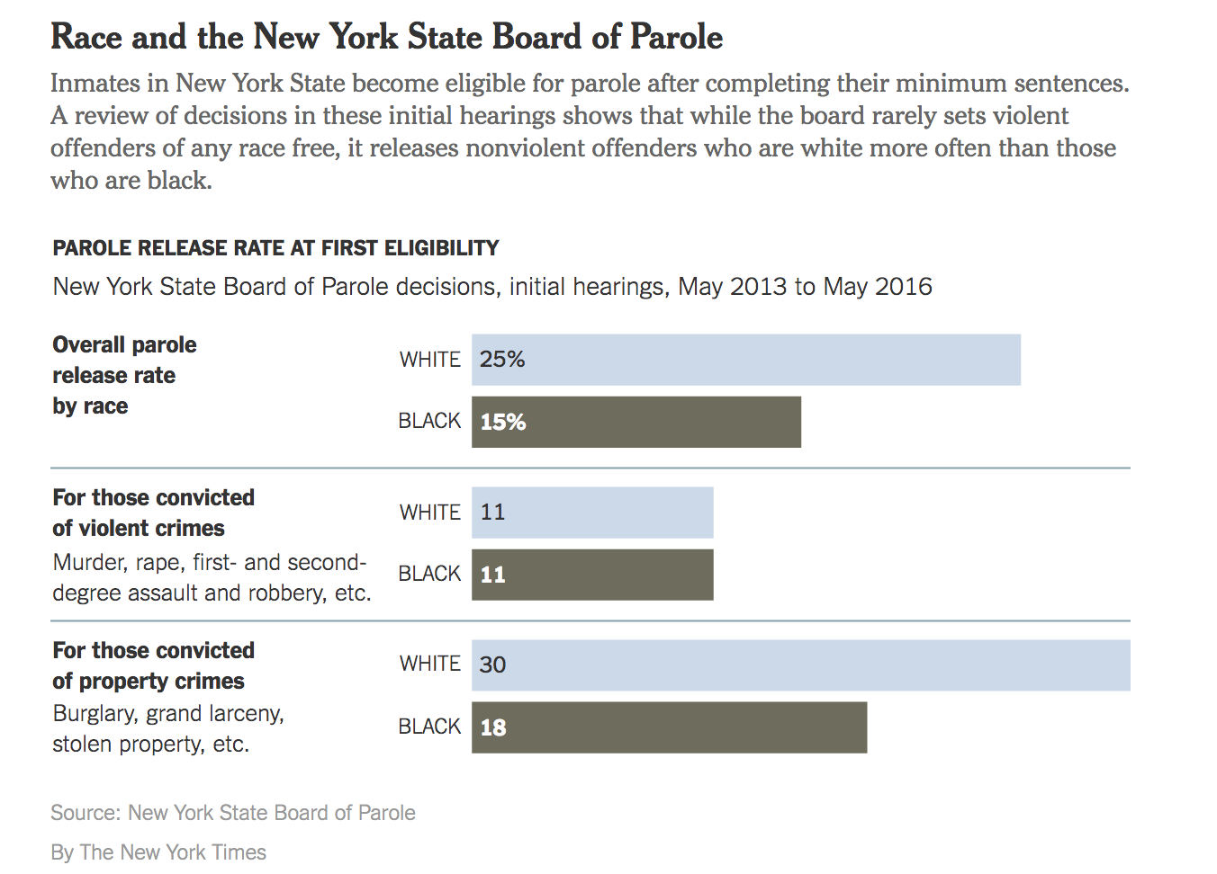
Diversity, Segregation and Disparity
IRE New York Watch Dog Workshop, January 27, 2017

Slide 40
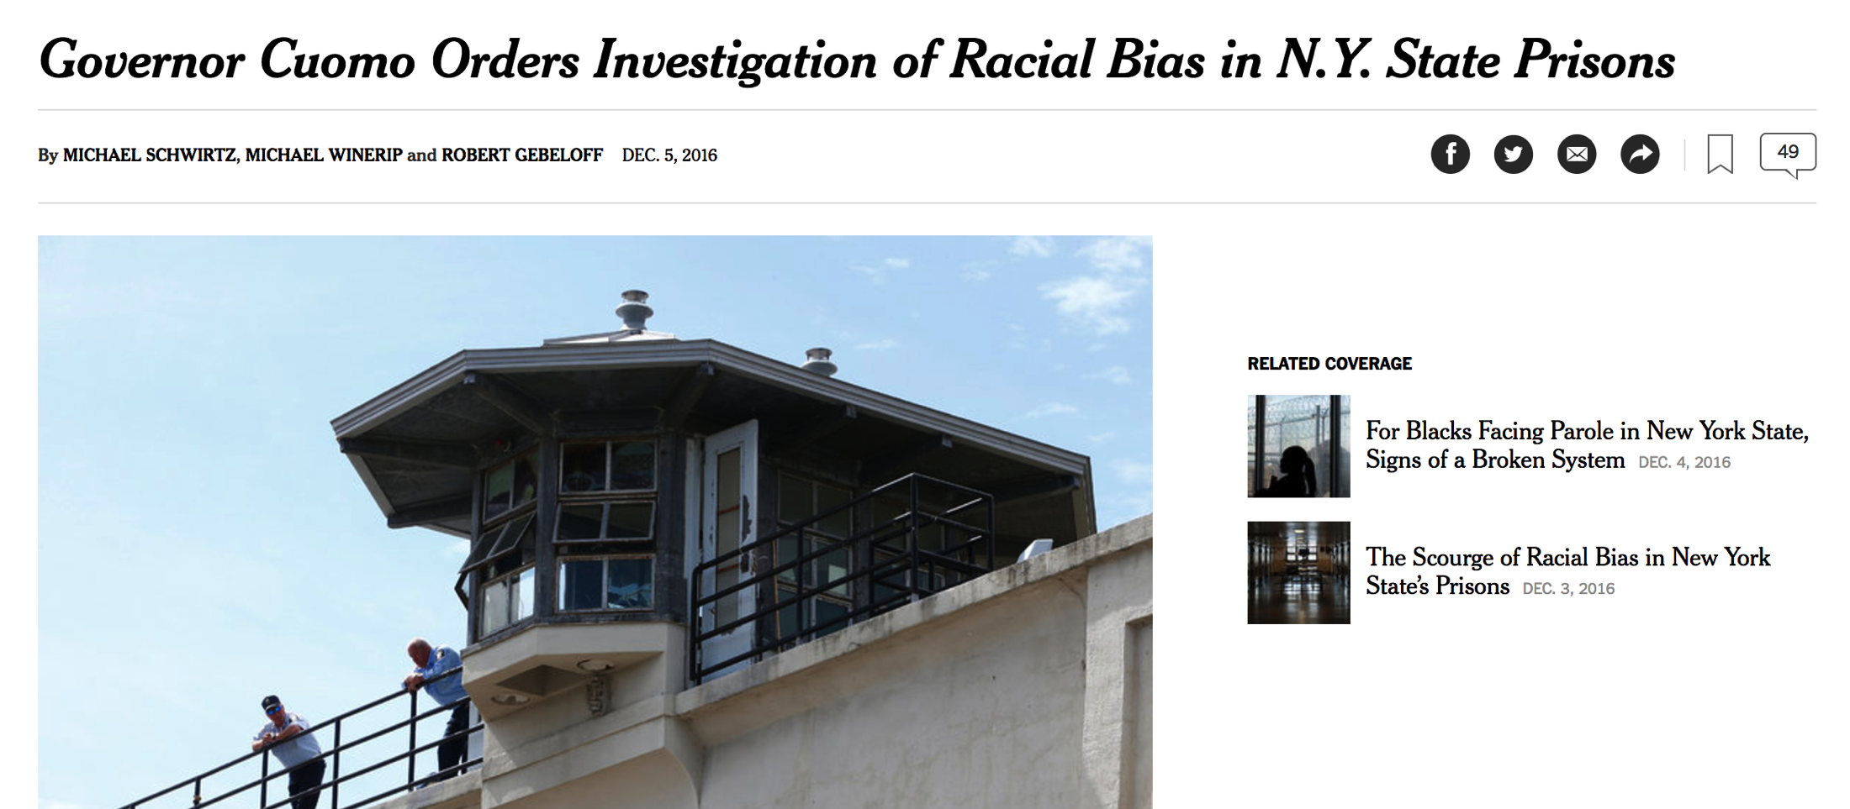
Diversity, Segregation and Disparity
IRE New York Watch Dog Workshop, January 27, 2017

